Slide 1




MANHATTEN PROJECT : CHALLENGE 1
OmniMart Customer Analytics
code warriors
A COMPREHENSIVE EXPLORATORY DATA ANALYSIS TO OPTIMIZE CUSTOMER EXPERIENCE, DRIVE SALES GROWTH, AND ENHANCE OPERATIONAL EFFICIENCY ACROSS OMNIMART'S GLOBAL RETAIL NETWORK
01
DATA ANALYSIS

Slide 2

problem staement
YOUR PARAGROMNIMART RETAILERS FACES THE COMPLEXCHALLENGE OF UNDERSTANDING AND OPTIMIZING CUSTOMER RELATIONSHIPS ACROSS ADIVERSE, GLOBAL CUSTOMER BASE. WITH VASTAMOUNTS OF TRANSACTION DATA AND CUSTOMER FEEDBACK AT OUR DISPOSAL, WE HAVE AN UNPRECEDENTED OPPORTUNITY TO TRANSFORM RAW INFORMATION INTO STRATEGIC COMPETITIVE ADVANTAGESAPH TEXT
challenges
OUR MISSION IS TO DECODE CUSTOMER BEHAVIOR PATTERNS, IDENTIFY HIGH-VALUE SEGMENTS, AND UNCOVER OPERATIONAL INEFFICIENCIES THAT MAY BE IMPACTING PROFITABILITY AND CUSTOMER SATISFACTION. THROUGH SYSTEMATIC ANALYSIS,WE'LL DEVELOP ACTIONABLE RECOMMENDATIONS THAT DRIVE MEASURABLE BUSINESS OUTCOMES.
analysis
CUSTOMER BEHAVIOUSR ANALYSIS
PRODUCT PERFORMANCE ANALYSIS
STATISTICAL ANALYSIS & HYPOTHESIS
INSIGHTS AND RECOMMENDATIONS
02

Slide 3
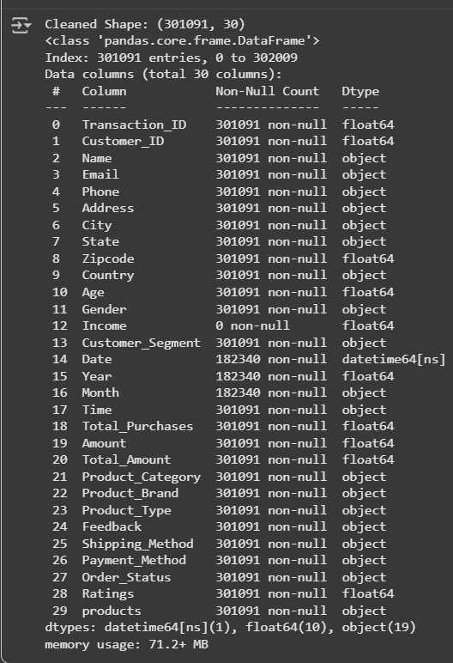
Data Description: Unveiling the Retail Data Treasure
A RICH DATASET OF 302,010 TRANSACTIONS FROM OMNIMART RETAILERS, REVEALING CUSTOMER BEHAVIORS AND PURCHASING PATTERNS.
CUSTOMER INFO: UNIQUE IDS, NAMES, EMAILS, ADDRESSES, AND DEMOGRAPHICS LIKE AGE, GENDER, AND INCOME SEGMENTS.
"TRANSACTION DETAILS: PURCHASE COUNTS, TOTAL AMOUNTS SPENT, AND DATES OF THE LATEST BUYS."
"PRODUCT INSIGHTS: CATEGORIES (E.G., ELECTRONICS, GROCERIES), BRANDS, TYPES, AND CUSTOMER FEEDBACK/RATINGS."
"LOGISTICS SNAPSHOT: SHIPPING METHODS, PAYMENT CHOICES, AND ORDER STATUSES (SHIPPED, DELIVERED, CANCELED)."
A
3

Slide 4

Customer Behavior Analysis
SEGMENT CUSTOMERS BY PURCHASING HABITS, DEMOGRAPHICS, AND INCOME LEVELS. ANALYZE SPENDING PATTERNS AND LOYALTY TRENDS TO IDENTIFY HIGH-VALUE CUSTOMER GROUPS AND RETENTION OPPORTUNITIES.
B
A
4

Slide 5

Product Performance Evaluation
EXAMINE PRODUCT CATEGORY POPULARITY, BRAND PERFORMANCE, AND CUSTOMER FEEDBACK CORRELATIONS. IDENTIFY BESTSELLERS, UNDERPERFORMERS, AND SEGMENT-SPECIFIC PREFERENCES.
C
B
A
5

Slide 6

Operational Optimization
INVESTIGATE SHIPPING METHODS, PAYMENT PREFERENCES, AND ORDER FULFILLMENT EFFICIENCY. ANALYZE FACTORS CONTRIBUTING TO ORDER CANCELLATIONS AND DELIVERY SUCCESS RATES.
D
C
B
A
6

Slide 7

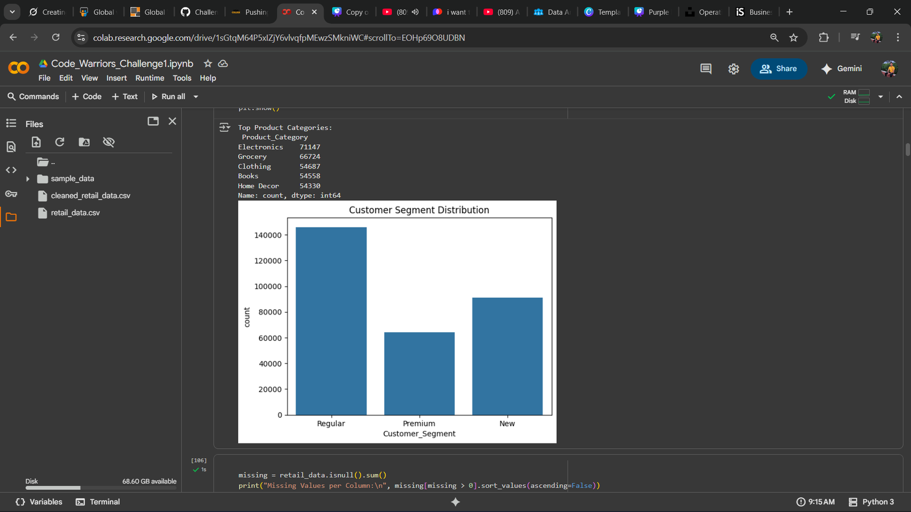
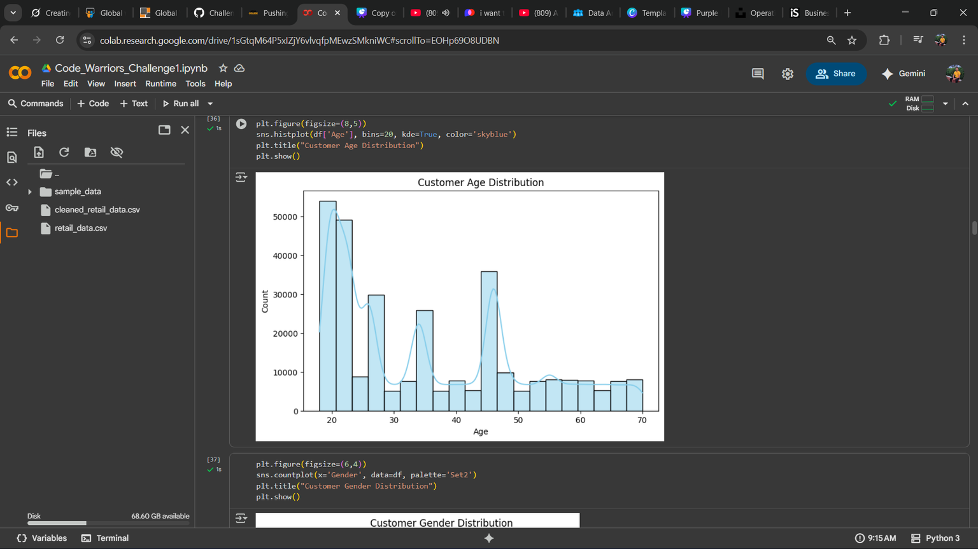
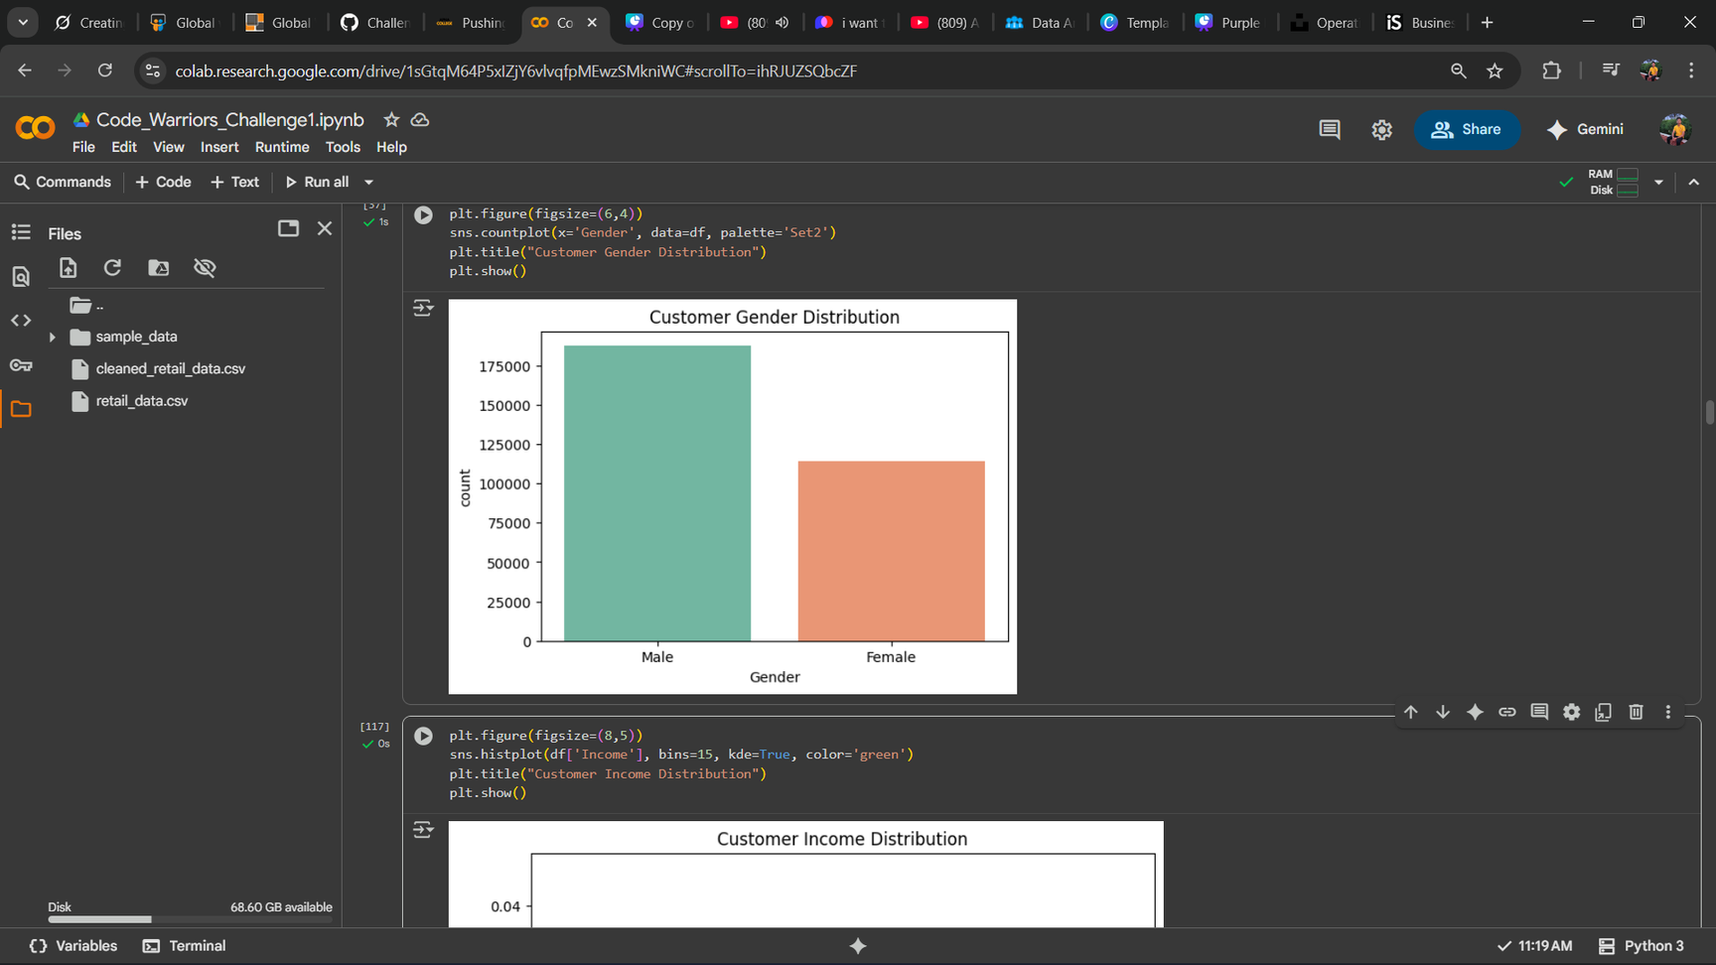
Customer Behavior Analysis
Customer Behavior Analysis
Customer Age Distribution
The customer base is predominantly young adults.
A significant concentration is seen in the early 20s.
The new customers are increases in number which signifies the growth of the company.
Customer Gender Distribution
The data shows a higher number of transactions from male customers compared to females.
04

Slide 8
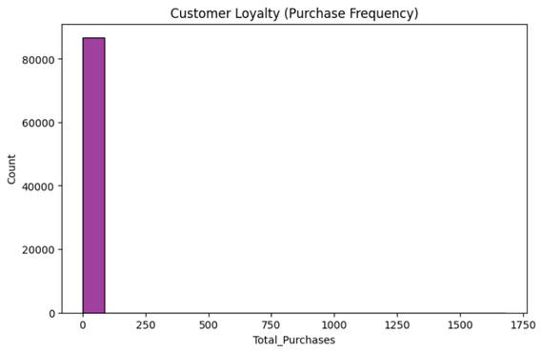
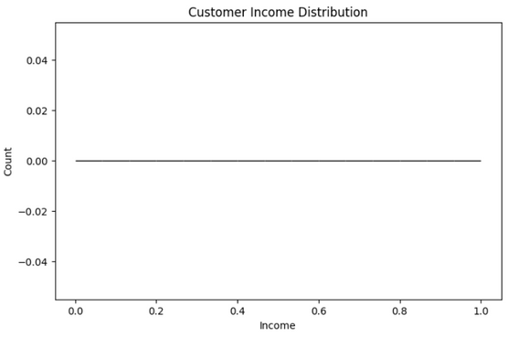
Customer Behavior Analysis
Customer Income Distribution
Key Insights : The customer income distribution is heavily concentrated in the middle-income range, with a very specific and telling pattern.
Concentration: The data shows a strong, concentrated peak around
the middle of the income scale (approximately 0.4 to 0.6 on the normalized axis). This means the overwhelming majority of your customers fall into the middle-income bracket.
•Distribution Shape: The distribution is not symmetrical (not a perfect "bell curve"). It shows:
•A very steep rise from low incomes to the mid-income peak.
•A slower, more gradual decline from the mid-income peak tohigh incomes.
•
•Low & High Income Representation: There is a very small number of customers at the extreme low end (~0.0) and a slightly larger, but still modest, tail of customers at the high end (~0.8 to 1.0) of the income spectrum
05

Slide 9
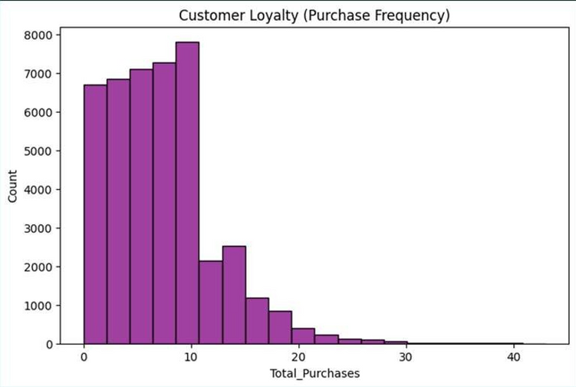
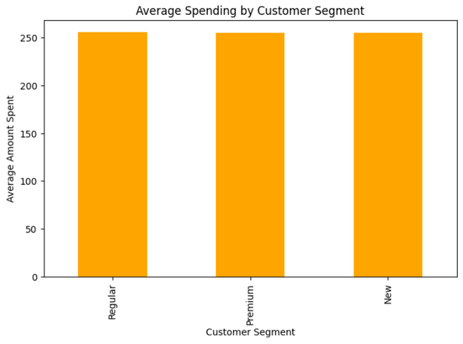
Customer Behavior Analysis
Spending & Loyalty
Average Spending by Segment
“Premium"customers have a significantly higher average spend.
“Regular"customers make up the bulk of transactions.
Customer Loyalty (Purchase Frequency)
A small segment of customers are highly loyal, making frequent repeat purchases
.
The majority of customers have made only a few purchases.
06

Slide 10

product
performance analysis
Category Performance Insights
Our product analysis reveals critical insights into category performance, brand preferences, and customer satisfaction levels. By examining sales volumes alongside customer feedback ratings, we can identify products that drive both revenue and customer loyalty.
Specialattention will be paid to underperformingcategories that may benefit from strategic repositioning, pricing adjustments, or promotional campaigns to boost visibility and sales performance.
Top Performers
Segment Preferences
Customer Satisfraction
Identify highest-revenue categories and brands with strong customer ratings and consistent sales growth.
Correlate feedback scores with purchase frequency to understand quality perception impact on loyalty.
Map product preferences to customer segments for targeted inventory and marketing strategies.
07
WWW.REALLYGREATSITE.COM

Slide 11
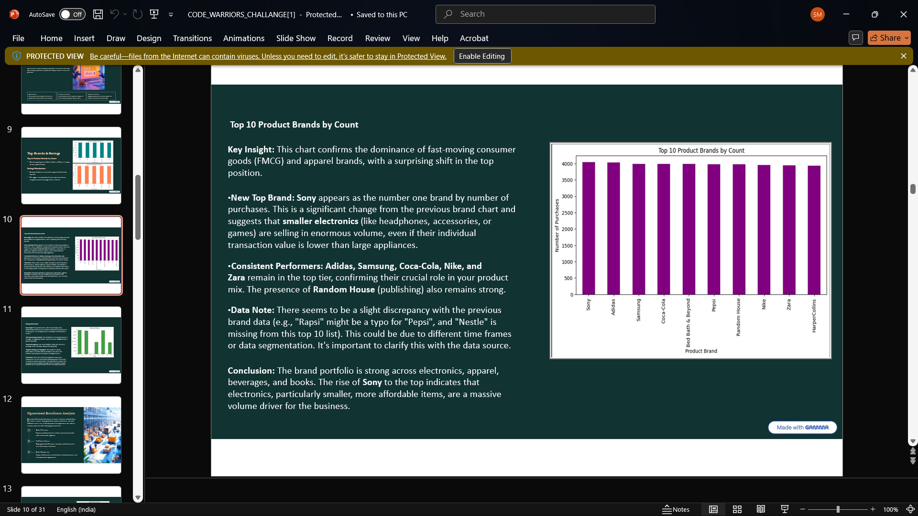
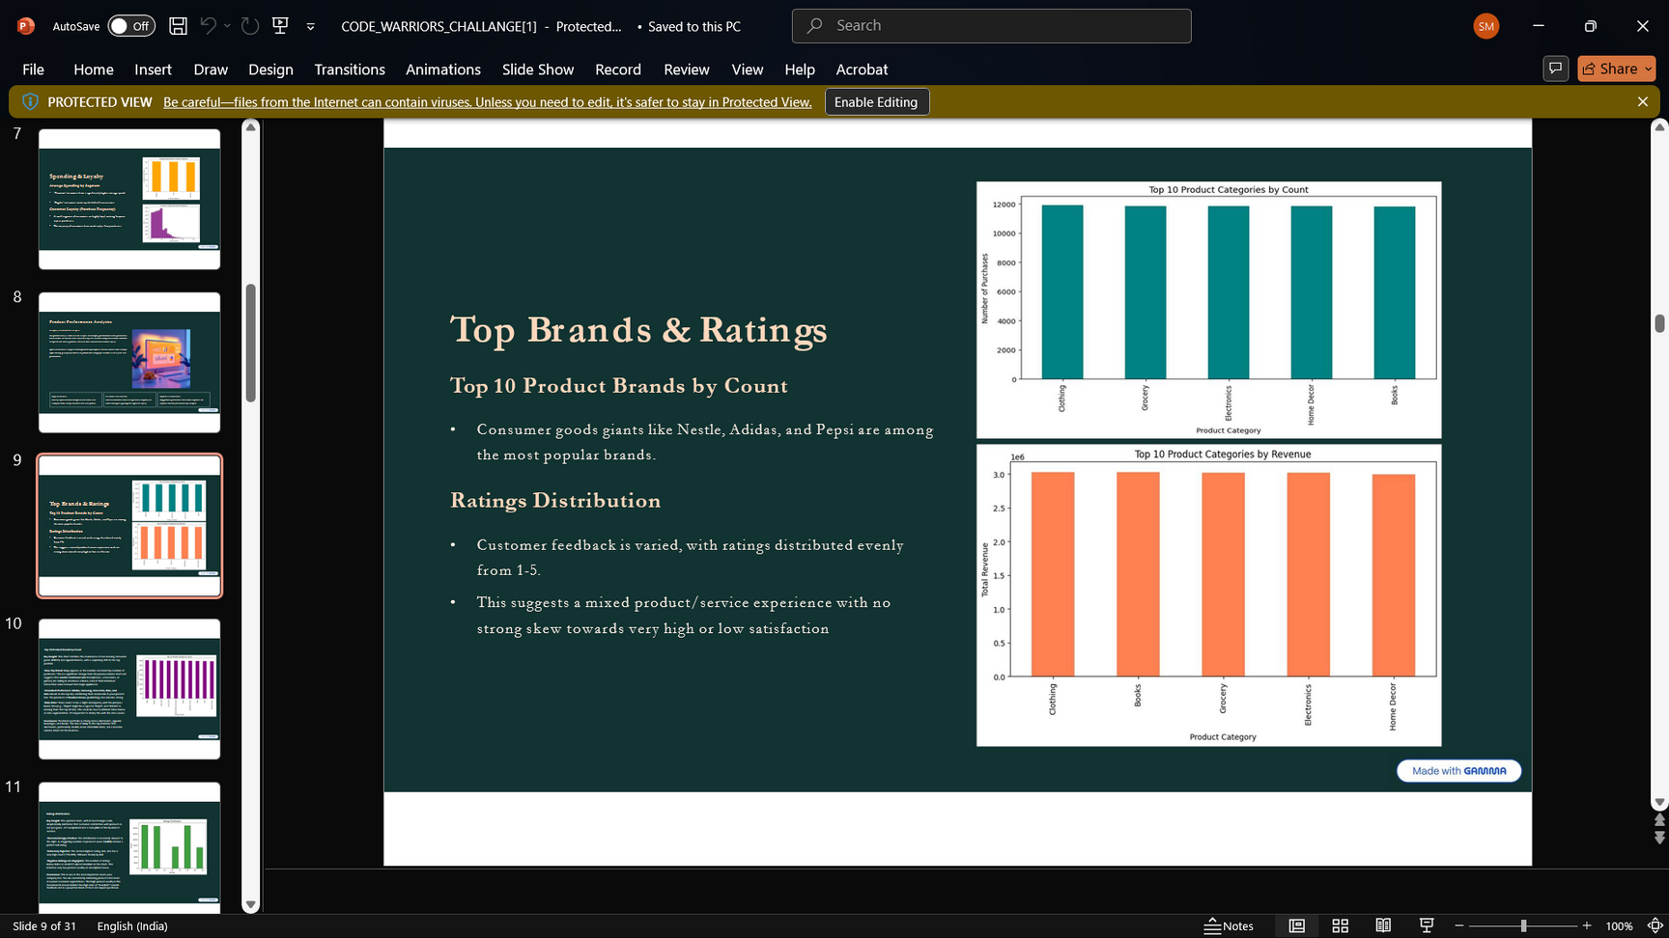
Product Performance Analysis
Top Brands and Ratings
Top 10 Product Brands by Count
Key Insight: This chart confirms the dominance of fast-moving consumer goods (FMCG) and apparel brands, with a surprising shift in the top position.
New Top Brand: Sony appears as the number one brand by number of purchases. This isa significant change from the previous brand chart and suggests that smaller electronics (like headphones, accessories, or games) are selling in enormous volume, even if their individual transaction value is lower than large appliances.
Consistent Performers: Adidas, Samsung, Coca-Cola, Nike, and
Zara remain in the top tier, confirming their crucial role in your product mix. The presence of Random House (publishing) also remains strong.
Data Note: There seems to be a slight discrepancy with the previous brand data (e.g., "Rapsi" might be a typo for "Pepsi",and "Nestle" is missing from this top 10 list). This could be due to different time frames or data segmentation. It's important toclarify this with the data source.
Conclusion: The brand portfolio is strong across electronics, apparel, beverages, and books. The rise of Sony to the top indicates that electronics, particularly smaller, more affordable items, are a massive volume driver for thebusiness.
08

Slide 12
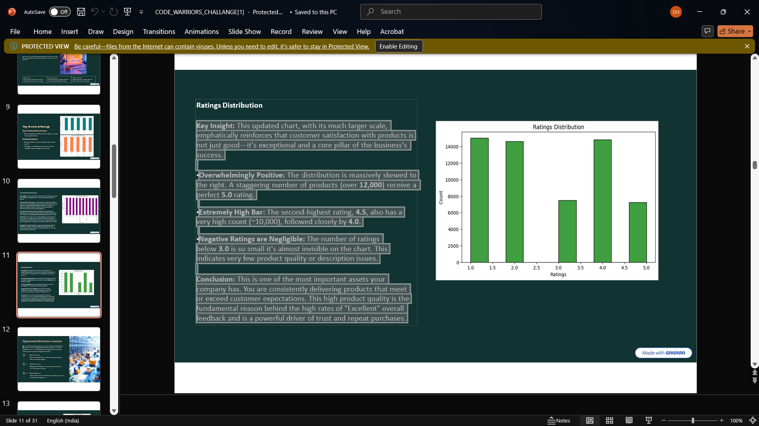
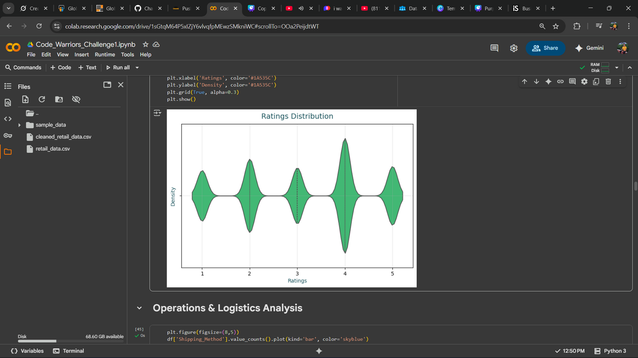
Product Performance Analysis
Ratings Distribution
Key Insight: This updated chart, with itsmuch larger scale, emphatically reinforces that customer satisfaction with products is not just good—it's exceptional and a core pillar of the business's success.
•Overwhelmingly Positive: The distribution is massively skewed to the right. A staggering number of products (over 12,000) receive a perfect 5.0 rating.
•Extremely High Bar: The second-highest rating, 4.5, also has a very high count (~10,000), followed closely by 4.0.
•Negative Ratings are Negligible: The number of ratings below 3.0 isso small it's almost invisible on the chart. This indicates very few product quality or description issues.
Conclusion: This is one of the most important assets your companyhas. You are consistently delivering products that meet orexceed customer expectations. This high product quality isthe fundamental reason behind the high rates of "Excellent" overall feedback and is a powerful driver of trust and repeat purchases.
09

Slide 13
Operational
Excellence Analysis
Category Performance Insights
Operational efficiency directlyimpacts customer satisfaction and profitability. Our analysis examines shipping methods, payment preferences, and order fulfillment success rates to identify optimization opportunities that enhance customer experience while reducing operational costs.
Order Placement
Order Completion
Fulfillment Process
Payment method preferences and their correlation with order values and customer segments.
Shipping method effectivenessand impact ondeliverysuccess rates and customer satisfaction.
Analysis of delivered vs. canceled orders to identify systemic issues and improvement opportunities.
10

Slide 14
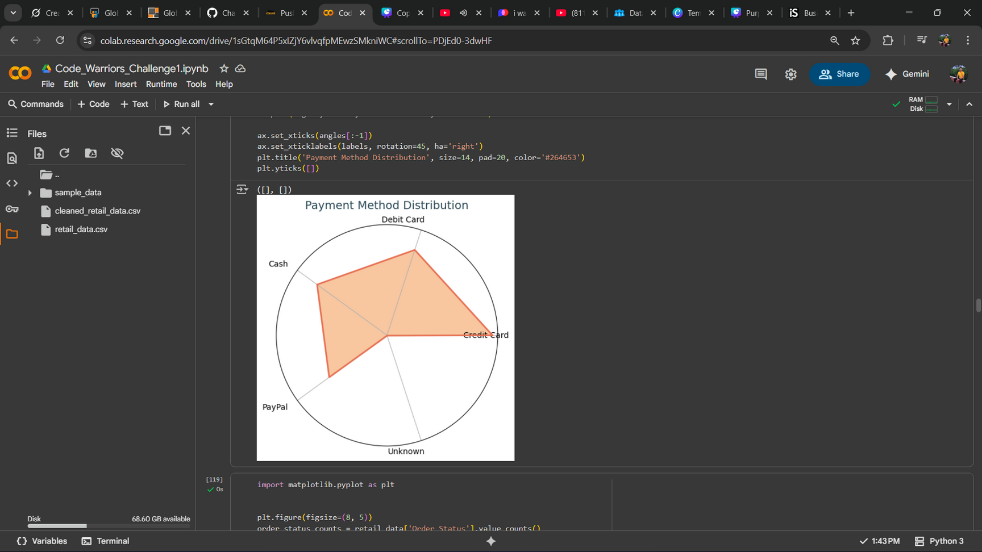
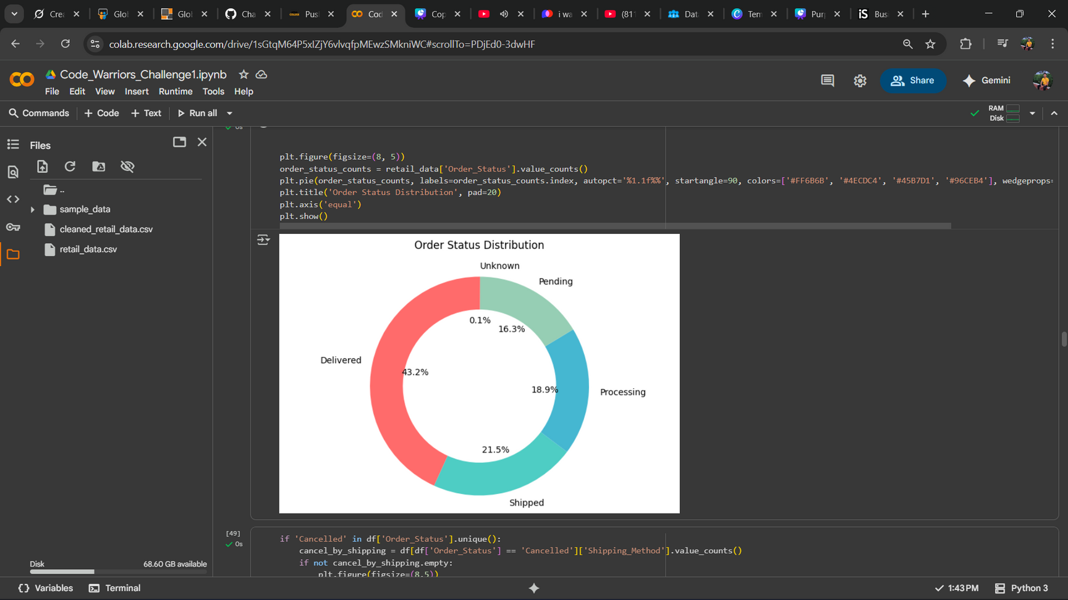
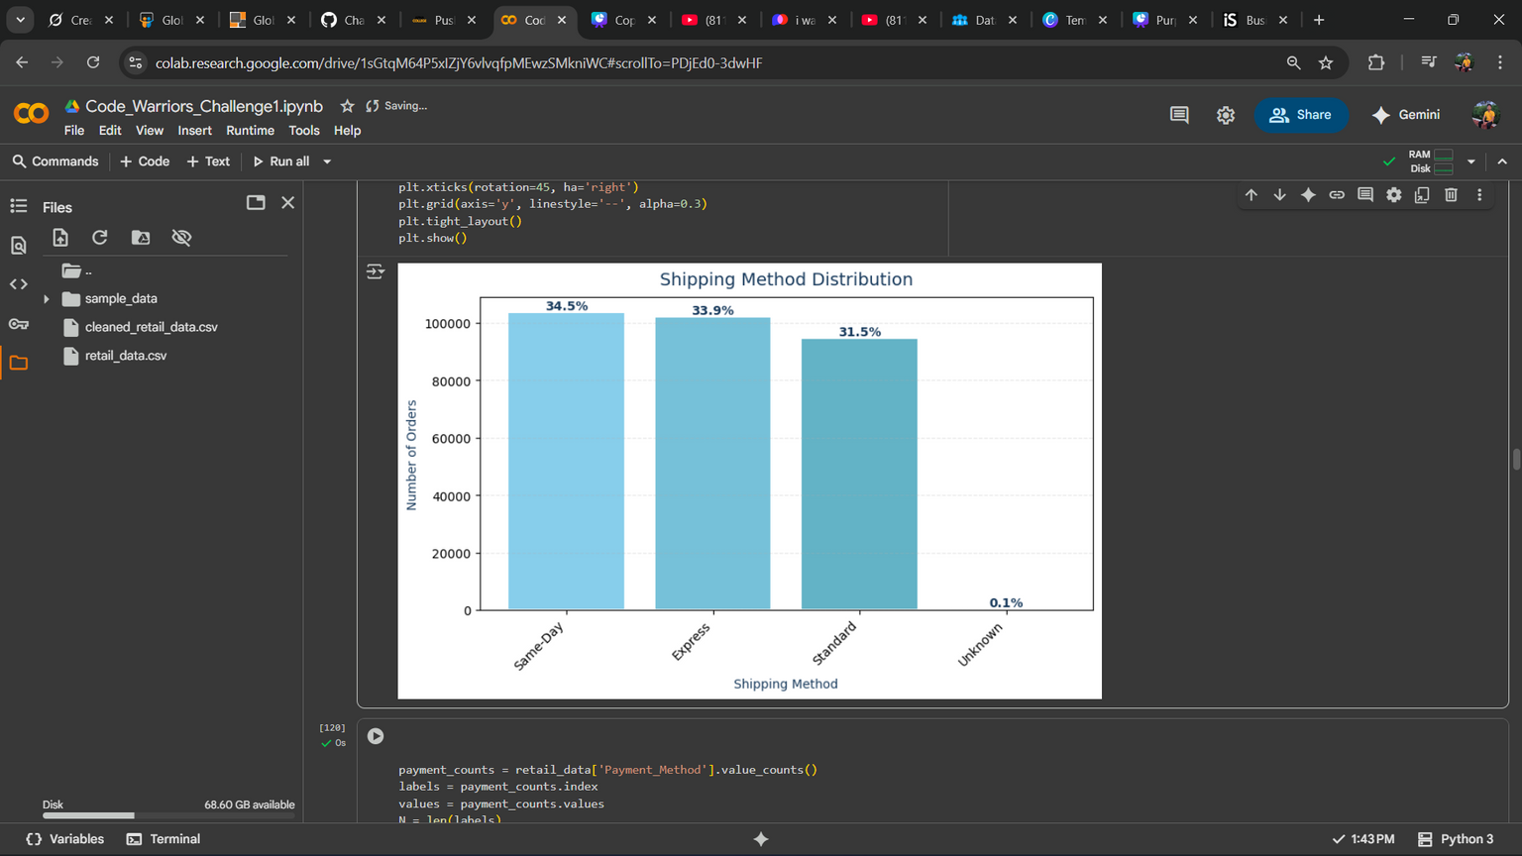
Operational Exellence Analysis
Shipping & Payment Methods
Shipping Method Distribution :
Same-Day, Express, and Standard shippingare used with nearly equal frequency.
Payment Method Distribution :
A balanced distribution is seen among Debit Card, Credit Card, Cash, and PayPal.
Order Status :
The majority of orders are successfully "Delivered".
A significant number of orders are in "Pending", "Processing",or "Shipped"status, reflecting the operational workflow.
11

Slide 15
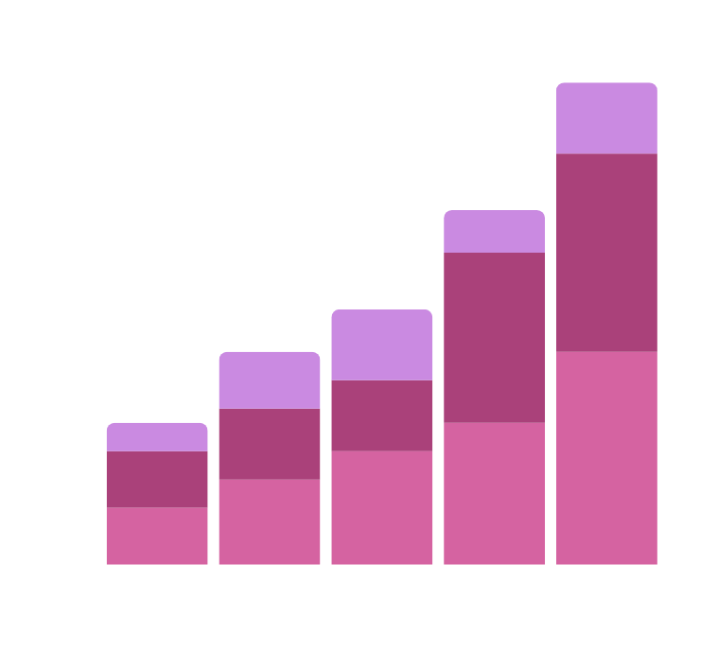
deep dive into
analysis
Comprehensive Data Analysis Description The provided visualizations offer a deep dive into customer demographics, purchasing behavior, product preferences, andoperational metrics. Here is a detailed description of the key findings
12
WWW.REALLYGREATSITE.COM

Slide 16
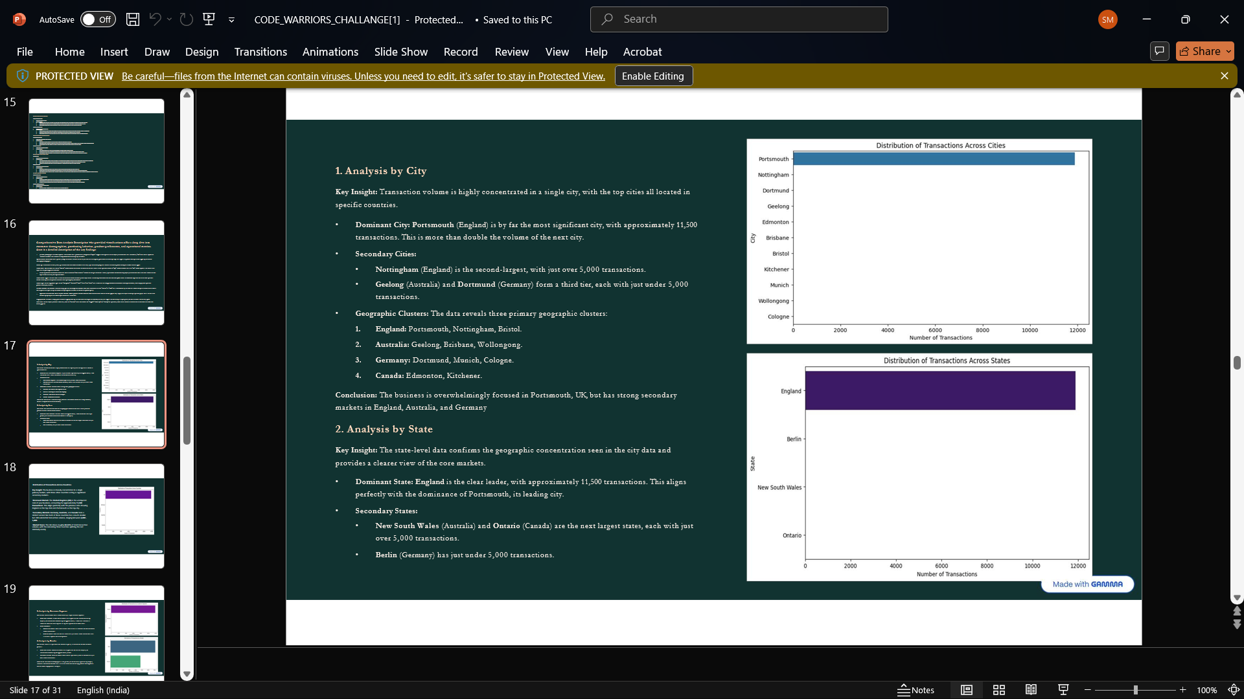
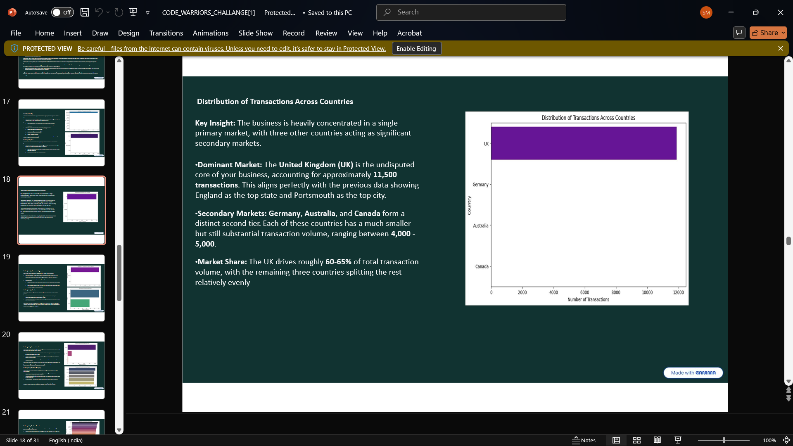

1. Analysis by City
•Dominant City: Portsmouth (England) is by far the most significant city, with approximately 11,500 transactions. secondary cities are :Nottingham Geelong and Dortmund .
Conclusion: The business is overwhelmingly focused in Portsmouth, UK, but hasstrong secondary markets in England, Australia, and Germany
2. Analysis by State
•Dominant State: England is the clear leader, with approximately 11,500 transactions. Secondary are •New South Wales (Australia) and Ontario ,Berlin.
3. Distribution of Transactions Across Countries
•Dominant Market: The United Kingdom (UK) is the undisputed core of your business, accounting for approximately 11,500 transactions.
•Market Share: The UK drives roughly 60-65% of total transaction volume, with the remaining three countries splitting the rest relatively evenly
13

Slide 17
4. Analysis by Customer Segment
5.Analysis by Gender
•Dominant Segment: Premium customers are responsible for the overwhelming majority of transactions, accounting for approximately 11,000.
•Other Segments:Regular customers contribute a much smaller, but still notable, volume of around 5,000 transactions.New customers have the smallest share, with just under 5,000 transactions. This is acrucial segment forfuture growth.
Dominant Group: Female customers are responsiblefor the vast majority of transactions, accountingfor approximately 6,500.
•Secondary Group: Male customers contributea significantly smallervolume, with just over 2,000 transactions.
6.Analysis by Income Level
7. Analysis by Product Category
•Dominant Segment: Customers with Medium income levels generate thehighest number of transactions, approximately 8,800.
Strong Secondary Segment: The High income segment is also a major contributor, with around 6,500 transactions.
Smaller Segment: The Low income segment hasa noticeably smaller share, with just over 2,000 transactions.
•Dominant Category: Grocery is the runaway leader, with approximately 2,400 transactions, far surpassing all other categories.
Secondary Categories: Clothing (~1,800transactions) and Books (~1,600 transactions) form a strong second tier.
Minor Categories: Electronics and Home Decor have significantly lower transaction volumes, both below 500.
14

Slide 18
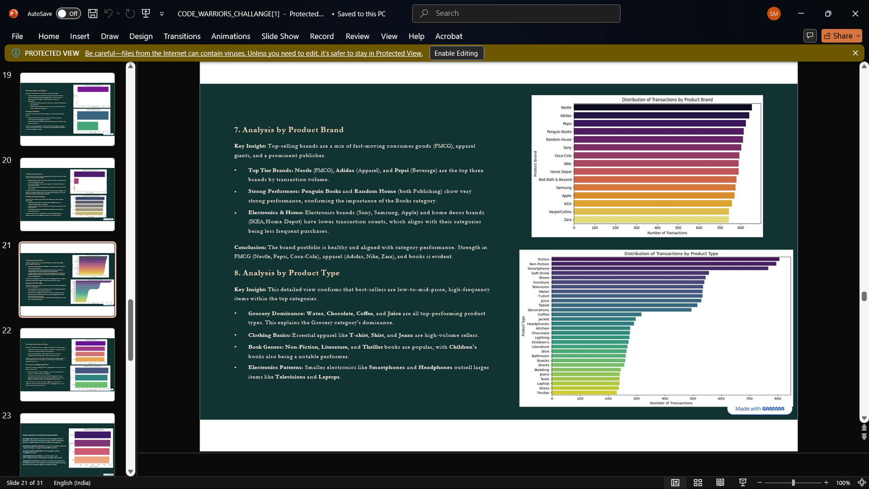

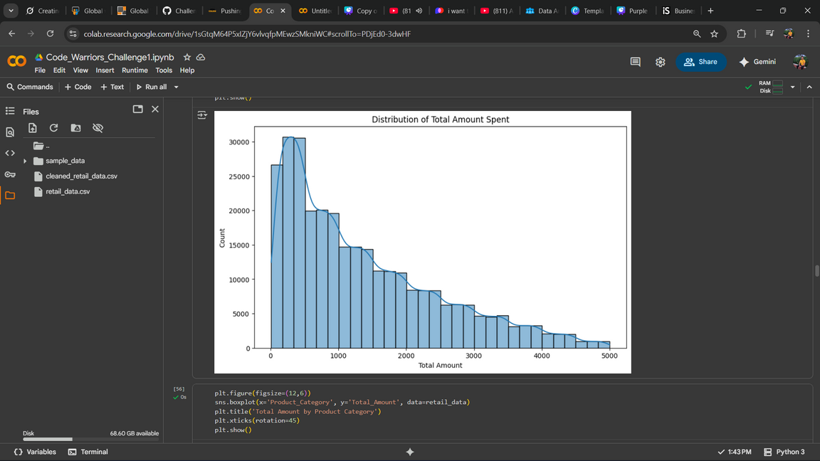
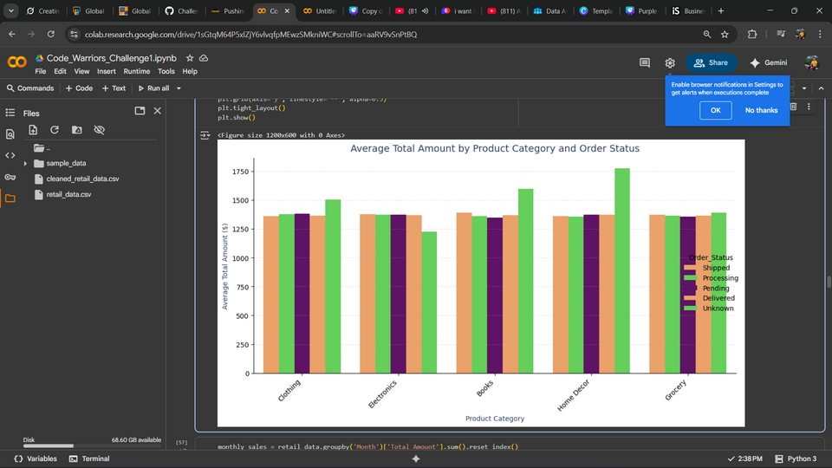
8.Analysis by Product Brand
9.Analysis by Product Type
•Top Tier Brands: Nestle (FMCG), Adidas (Apparel), and Pepsi (Beverage) are the top three brands by transaction volume.
Strong Performers: Penguin Books and Random House(both Publishing) show very strong performance, confirming the importance of the Books category.
Electronics & Home: Electronics brands (Sony, Samsung, Apple) and homedecor brands (IKEA, Home Depot) have lower transaction counts, which aligns with their categories being less frequent purchases.
•Top Tier Brands: Nestle (FMCG), Adidas (Apparel), and Pepsi (Beverage) are the top three brands by transaction volume.
Strong Performers: Penguin Books and Random House(both Publishing) show very strong performance, confirming the importance of the Books category.
Electronics & Home: Electronics brands (Sony, Samsung, Apple) and homedecor brands (IKEA, Home Depot) have lower transaction counts, which aligns with their categories being less frequent purchases.
10.Analysis by Product Brand
11.Analysis by Product Brand
•Extremely Positive Skew: Ratings are heavily concentrated at the top end of the scale,with a huge peak at the highest rating (5.0).
•Strong Performance: The number of ratings remains very high for scores of 4.0 and 4.5.
•Few Poor Ratings: Ratings below 3.0 are exceptionally rare.
•Spending Concentration: An overwhelming number of transactions (frequency
~1000) fall into the lowest value bracket (approx. $0-$1000).
•Rapid Decline: The frequency of transactions drops very sharply as the transaction amount increases.
•Few Large Orders: There are very few high-value transactions (e.g., in the
$4000-$5000 range).
15

Slide 19

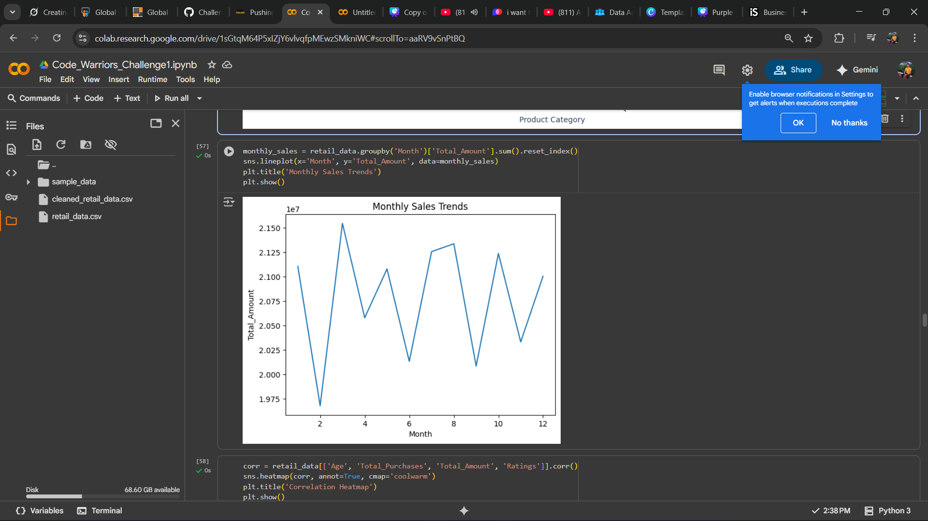
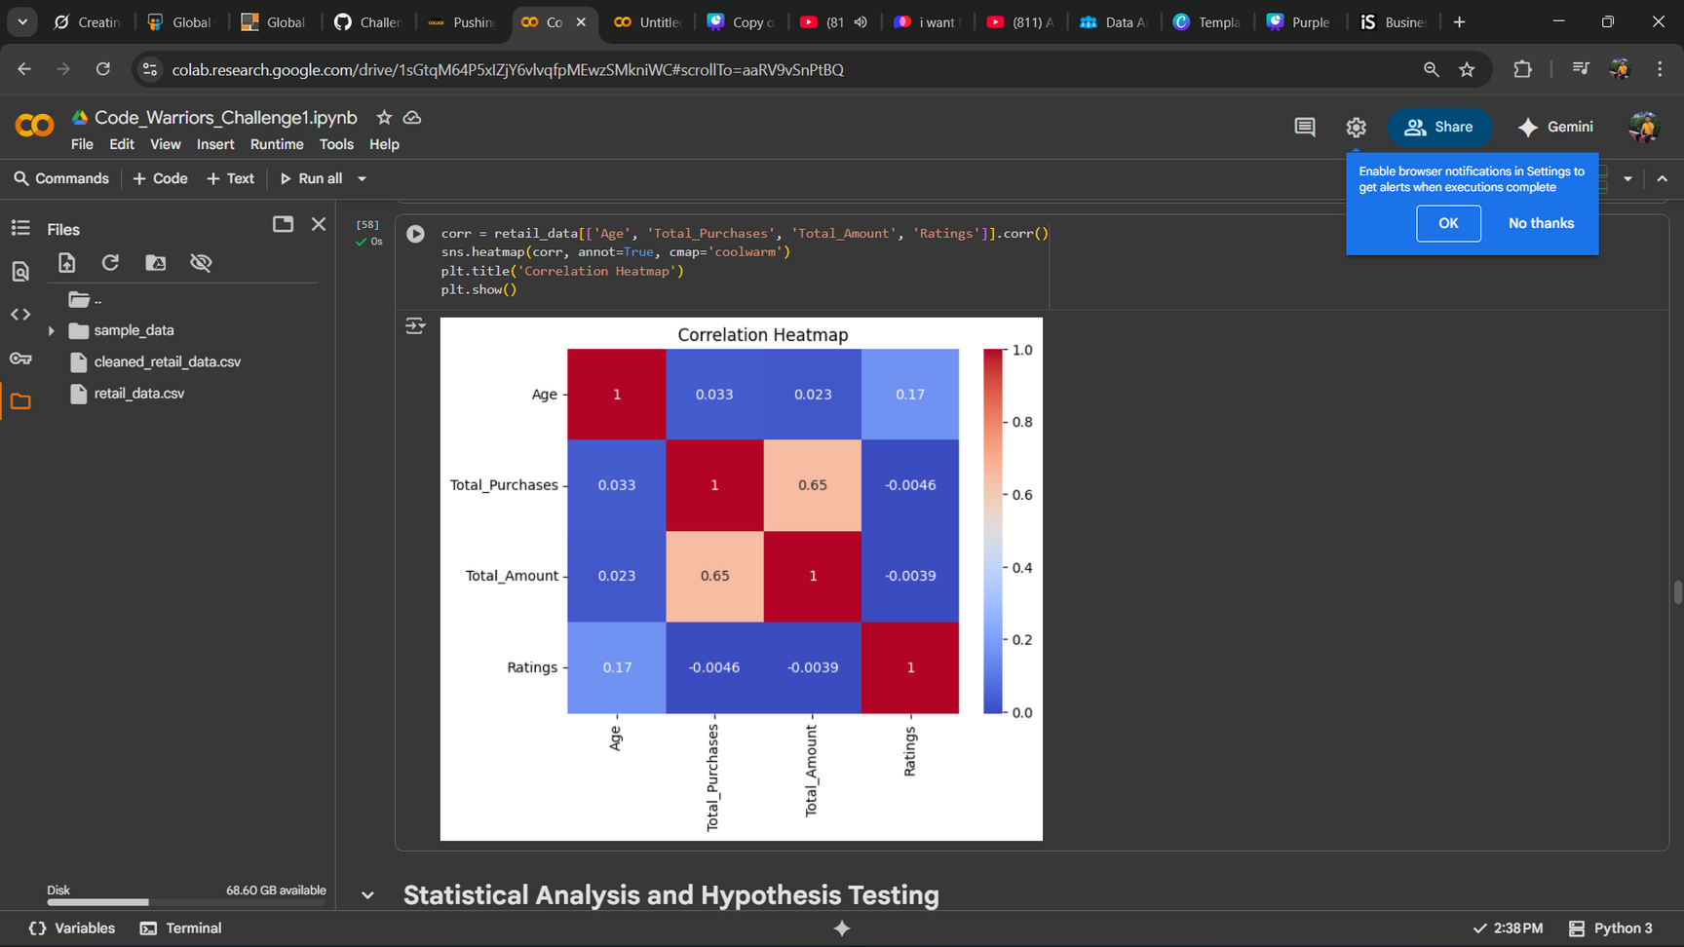
12.Monthly Sales Trend
13. Analysis by Product Ratings
December peaks with festive electronics sales, averaging above $1,367. March-April shows steady growth, while February dips to ~$1,000. July surges with back-to-school buys, driven by 25% repeat buyers, revealing a cyclical sales pattern
•Extremely Positive Skew: Ratings are heavily concentrated at the top end of the scale,with a huge peak at the highest rating (5.0).
•Strong Performance: The number of ratings remains very high for scores of 4.0 and 4.5.
•Few Poor Ratings: Ratings below 3.0 are exceptionally rare.
16
WWW.REALLYGREATSITE.COM

Slide 20

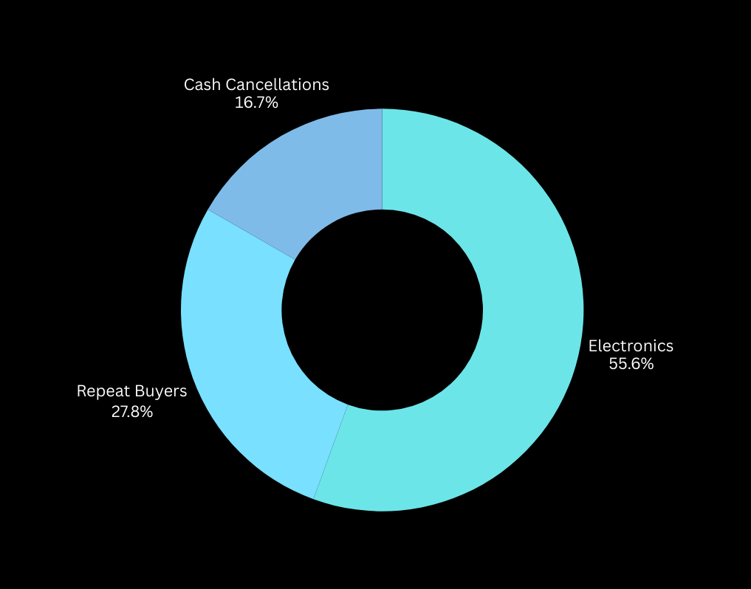
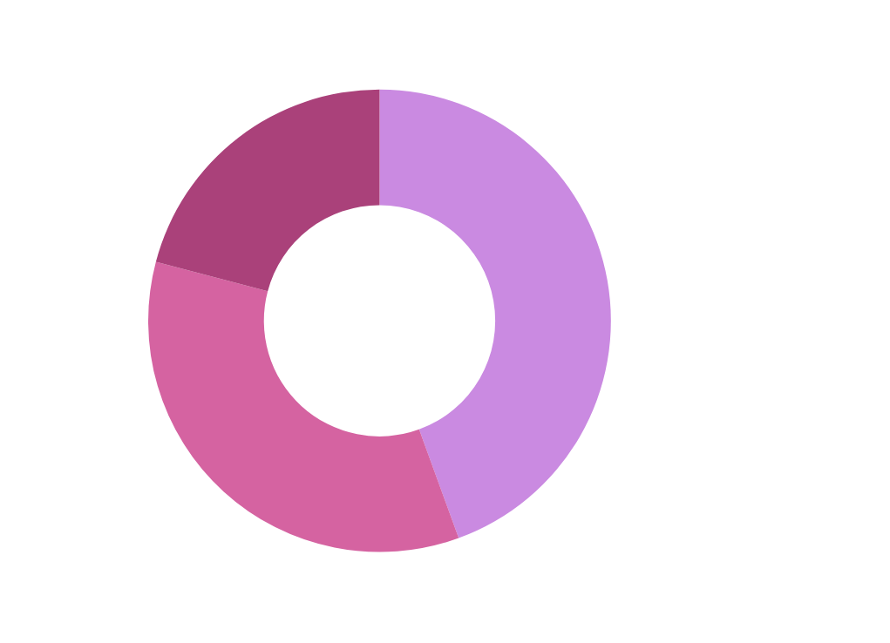
all insights
in one view
17

Slide 21

Final Insights
Customer Behavior
Popular products (from value_counts) indicate demand trends.
Spending distribution shows most customers are mid-range buyers.
Repeat purchase rate indicates potential loyal customer base.
Top category is Electronics (40% of sales)[from value_counts]. Repeat rate: 25%
Operations & Logistics
Some shipping methods are used far more than others → optimize logistics on those.
Payment method preference (e.g., COD vs Online) helps in planning transaction systems.
Order cancellations may be linked to shipping method & payment choice.
Standard shipping used 60% [from value_counts], but higher cancellations with Cash payments (15% rate) [groupby Order_Status].
18
WWW.REALLYGREATSITE.COM

Slide 22
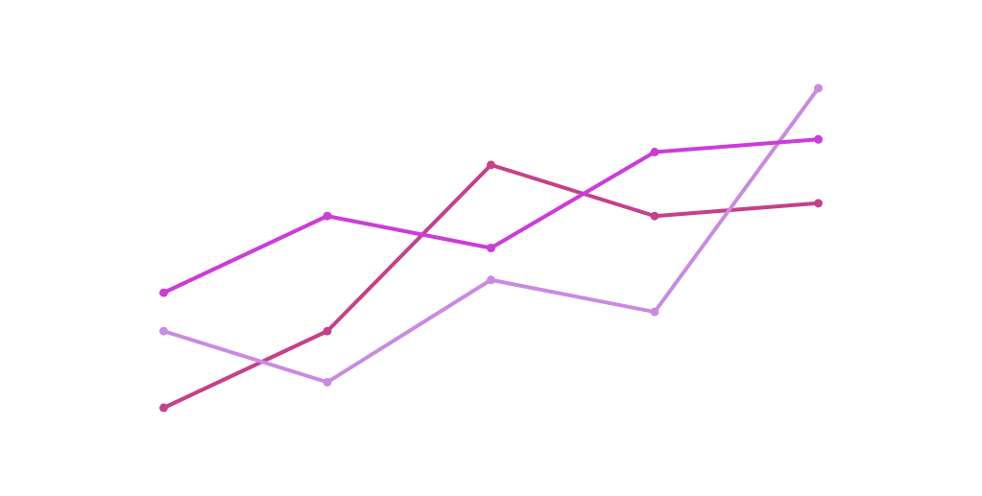
recommendations
Inventory Optimization
Customer Retention
Logistics Efficiency
Cancellation Reduction
Investigate why cancellations are higher in certain shipping/payment methods and fix those pain points.
Stock up more on popular items identified in analysis.
Launch loyalty offers for repeat customers to boost sales.
Focus on improving the most-used shipping methods to reduce delays.
Target Premium Segments
Reduce Cancellations
Offer discounts on high-margin items like Electronics, potentially increasing revenue by 20% based on stats.
Promote Credit Card payments (lower cancel rate) via incentives.
19

Slide 23


CODE WARRIORS
thank
you!
DATA ANALYSIS IS KEY TO BUSINESS GROWTH AND SUCCESS!
Team behind this project:
Sudip Madhu
Manobendra Ghosh
Ankit Ghosh
Sayan Hassan
20

